Slide 1
Collections in Java
What is a framework in Java
What is Collection framework
List

Slide 2
Collections in Java
The Collection in Java is a framework that provides an architecture to store and manipulate the group of objects.
Java Collections can achieve all the operations that you perform on a data such as searching, sorting, insertion, manipulation, and deletion.
Java Collection means a single unit of objects. Java Collection framework provides many interfaces (Set, List, Queue, Deque) and classes (ArrayList, Vector, LinkedList, PriorityQueue, HashSet, LinkedHashSet, TreeSet).

Slide 3
What is Collection in Java
A Collection represents a single unit of objects, i.e., a group.

Slide 4
What is a framework in Java
It provides readymade architecture.
It represents a set of classes and interfaces.
It is optional.

Slide 5
What is Collection framework
The Collection framework represents a unified architecture for storing and manipulating a group of objects. It has:
Interfaces and its implementations, i.e., classes
Algorithm

Slide 6
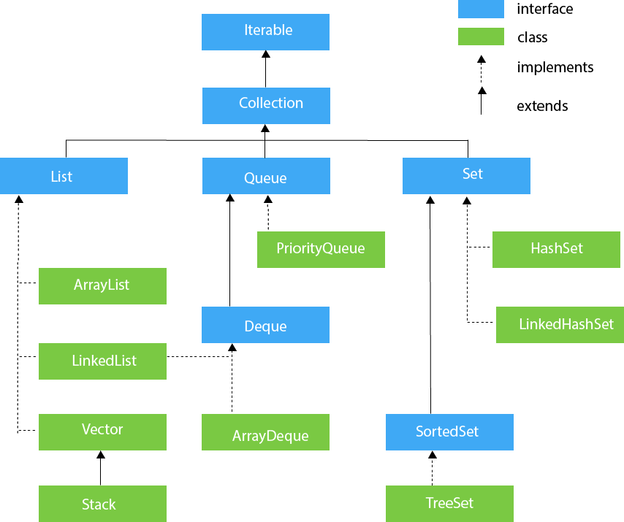
Hierarchy of Collection Framework

Slide 7
Methods of Collection interface
There are many methods declared in the Collection interface.

Slide 8
Iterator interface
Iterator interface provides the facility of iterating the
elements in a forward direction only.

Slide 9
Methods of Iterator interface
There are only three methods in the Iterator interface.

Slide 10
Iterable Interface
The Iterable interface is the root interface for all the collection classes. The Collection interface extends the
Iterable interface and therefore all the subclasses of Collection interface also implement the Iterable interface.
It contains only one abstract method. i.e.,
Iterator<T> iterator()
It
returns the iterator over the elements of type T.

Slide 11
Collection Interface

Slide 12
List Interface
List <data-type> list1= new ArrayList();
List <data-type> list2 = new LinkedList();
List <data-type> list3 = new Vector();
List <data-type> list4 = new Stack();

Slide 13
ArrayList
The ArrayList class implements the List interface. It uses a dynamic array to store the duplicate element of different data types.
The ArrayList class maintains the insertion order and is non-synchronized. The elements stored in the ArrayList class can be randomly accessed.

Slide 14
LinkedList
LinkedList implements the Collection interface. It uses a doubly linked list internally to store the elements.
It can store the duplicate elements. It maintains the insertion order and is not synchronized.
In LinkedList, the manipulation is fast because no shifting is required.

Slide 15
Vector
Vector uses a dynamic array to store the data elements. It is similar to ArrayList. However, It is synchronized and contains many methods that are not the part of Collection framework.
Consider the following example.
Vector<String> v=new Vector<String>();
v.add(“Some Name");
Iterator<String> itr=v.iterator();
while(itr.hasNext()){
System.out.println(itr.next());
}
}

Slide 16
Stack
The stack is the subclass of Vector. It implements the last-in-first-out data structure, i.e., Stack. The stack contains all of the methods of Vector class and also provides its methods like boolean push(), boolean peek(), boolean push(object o), which defines its properties.
Consider the following example.
Stack<String> stack = new Stack<String>();
stack.push("Ayush");
stack.pop();
Iterator<String> itr=stack.iterator();
while(itr.hasNext()){
System.out.println(itr.next());
}
}
}

